Slide 1
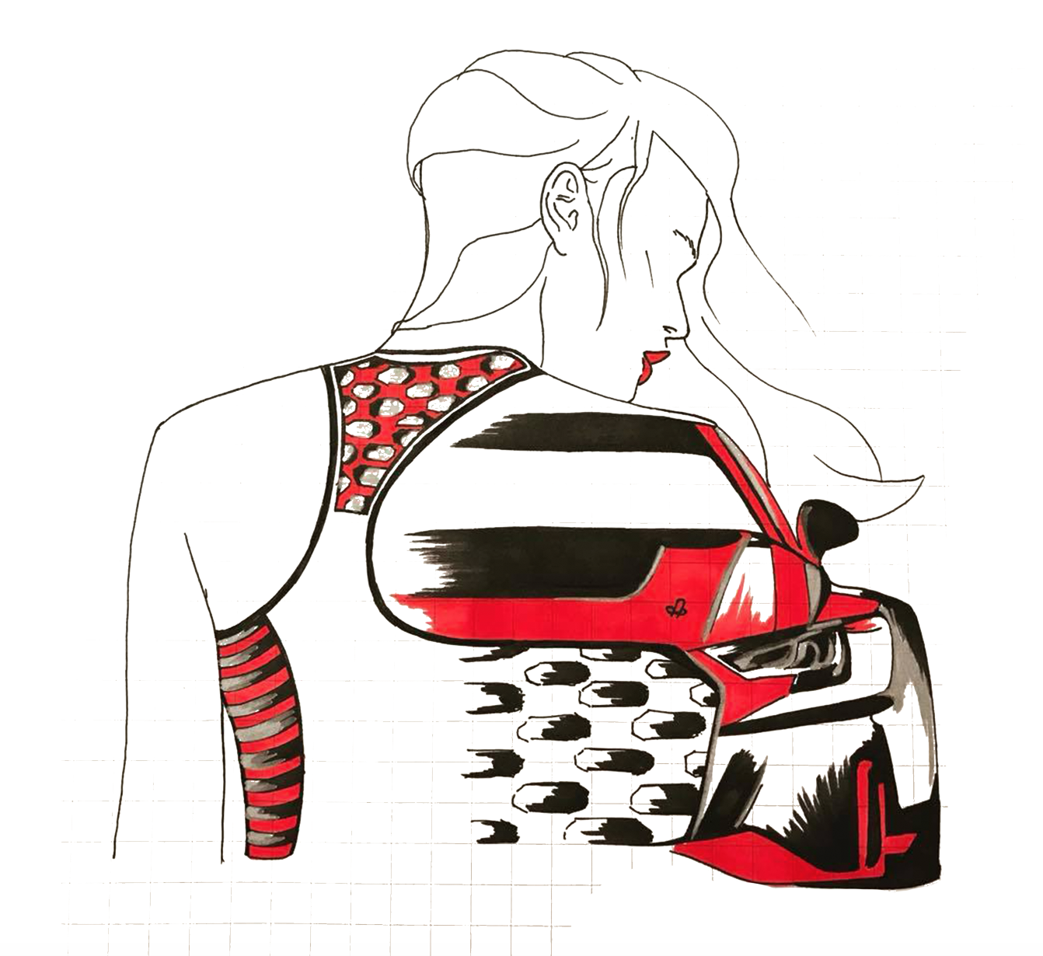
WHERE I WAS,
WHERE I AM,
WHERE I WANT TO BE.
EMILY REVELL
ASPIRING FASHION DESIGNER.

Slide 2
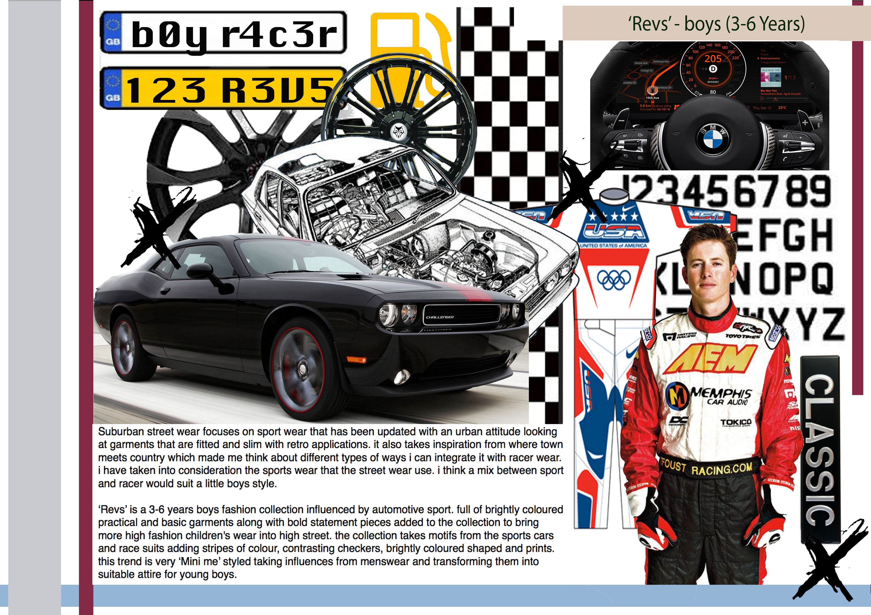
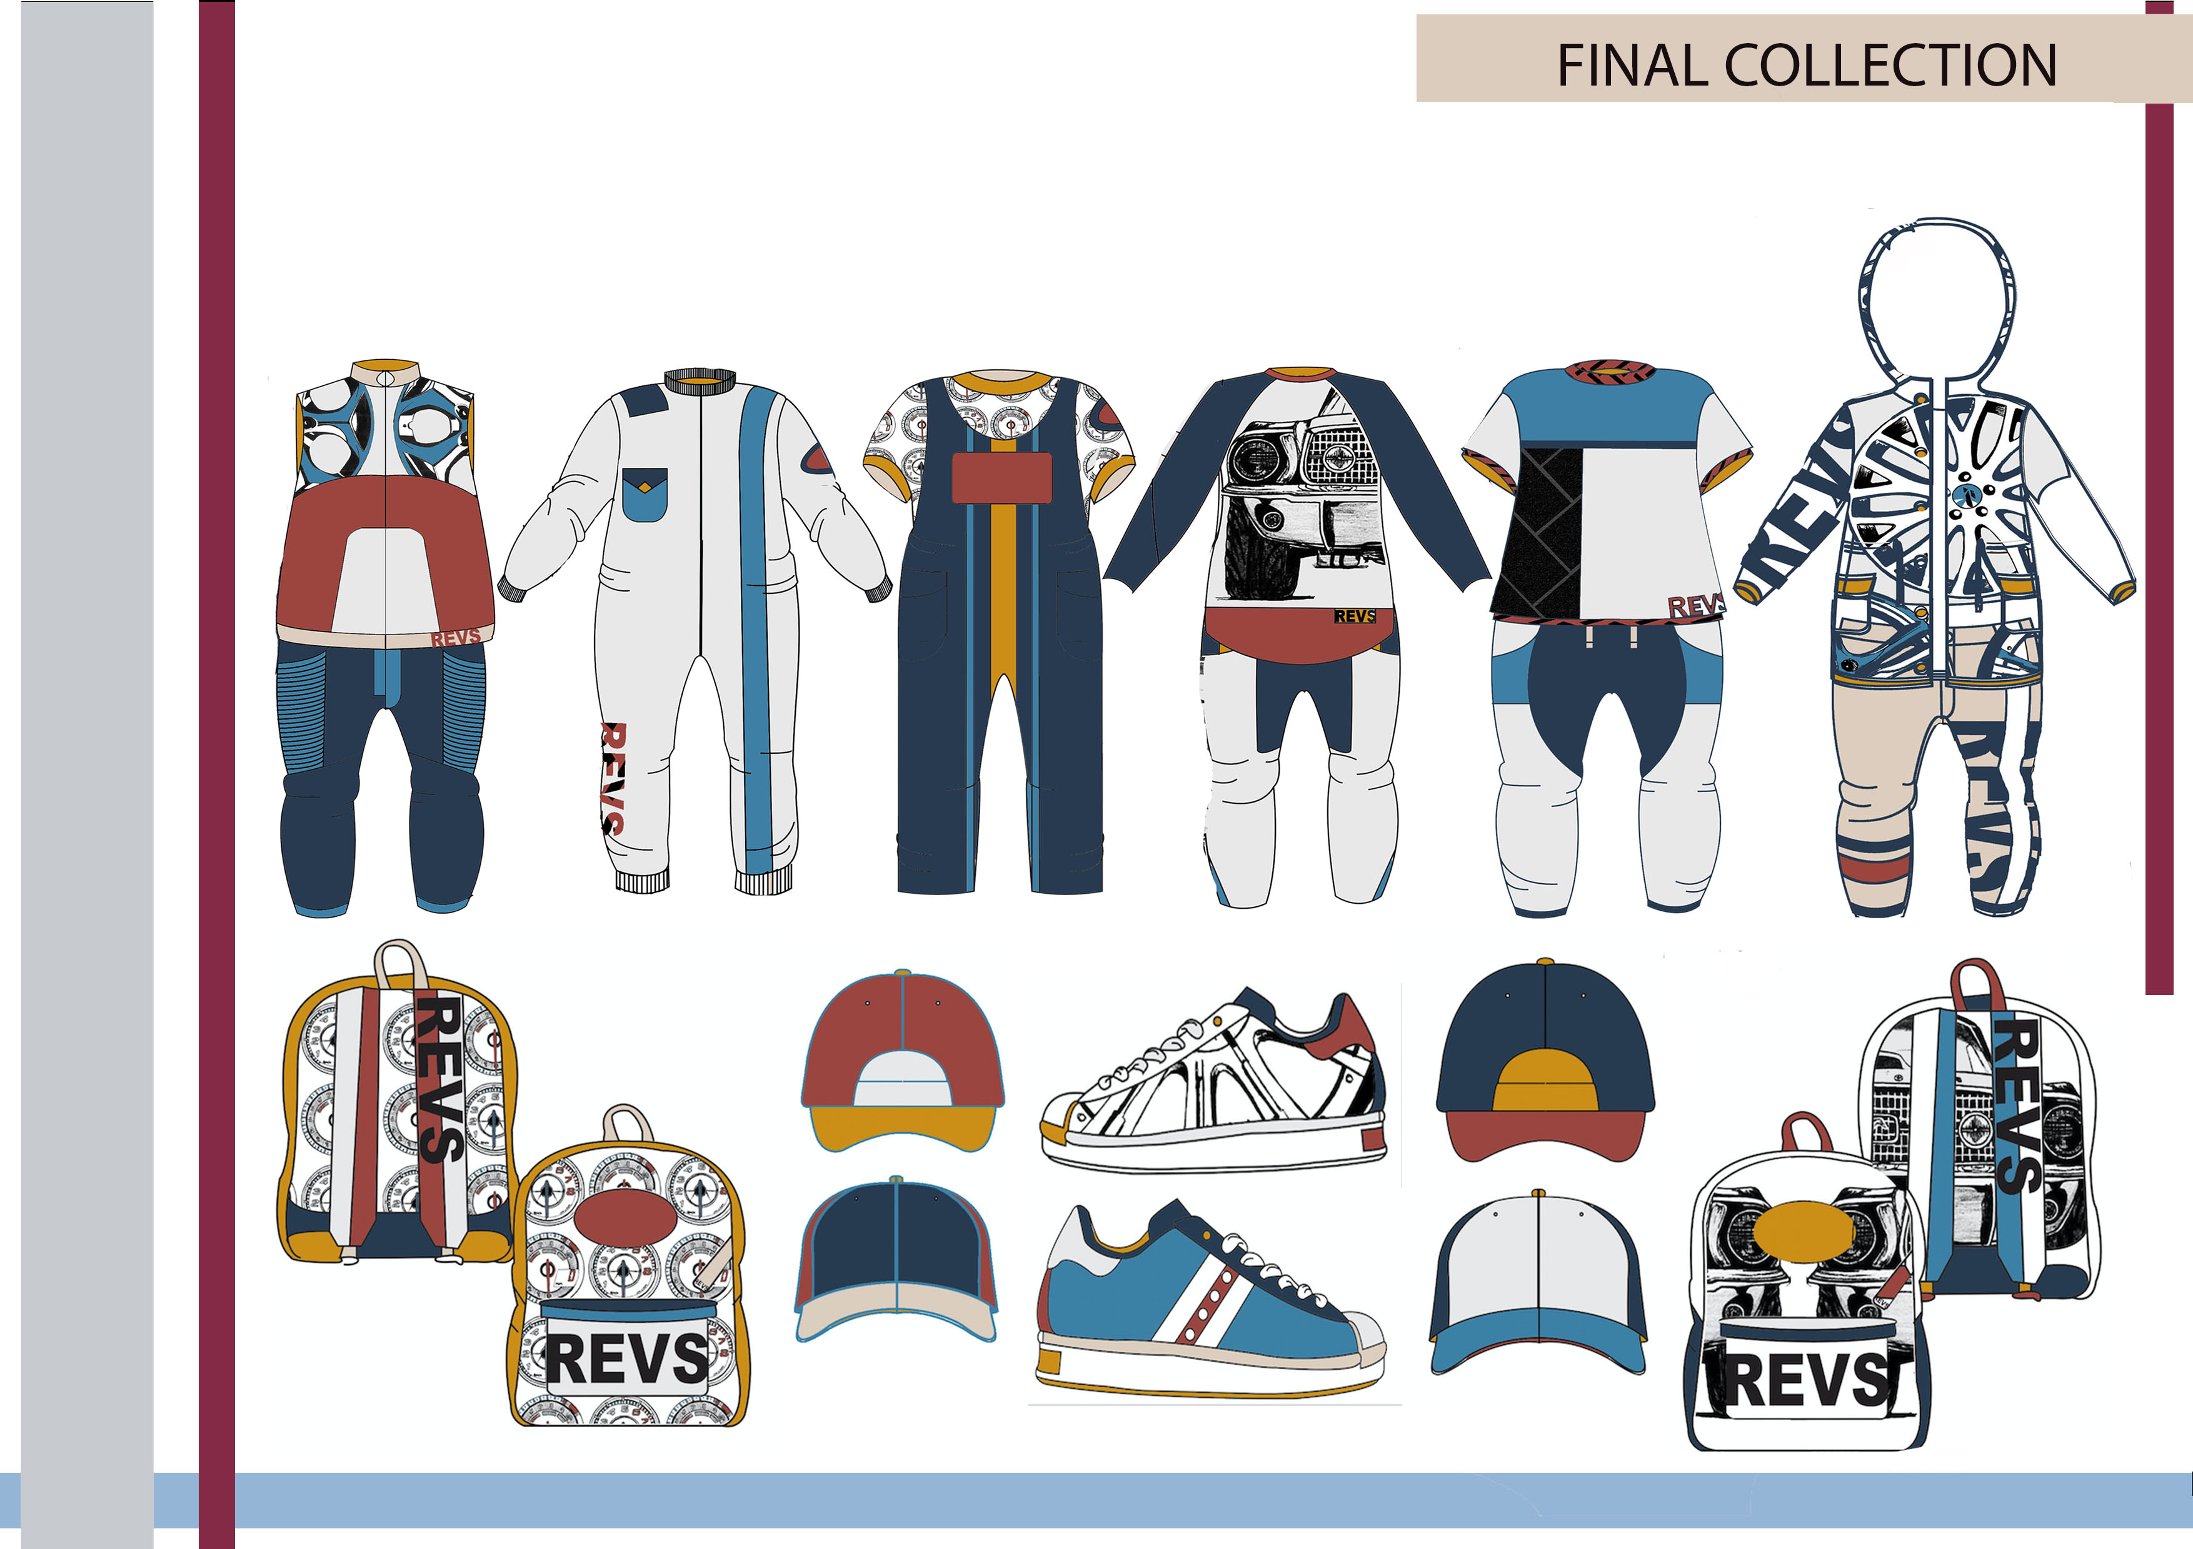
WHERE I WAS.
Before starting my degree I always wanted to be a designer of fashion and textiles. But it quickly became obvious that I wasn’t as invested to textiles than I was construction.
My second year was more of an eye opener to what direction in design I wanted to go down. There was more creative freedom that showed me I wasn't just a womenswear designer. I've always wanted to test my boundaries and design for mens and children.
So in this year I decided to give a children’s based project a go. I started building a portfolio around 3-6 year old boys wear concept named ‘revs’ a little racer. I then went on to present this portfolio to Tanya from Paul denecci who then offered me a paid internship for 8 weeks throughout summer.

Slide 3
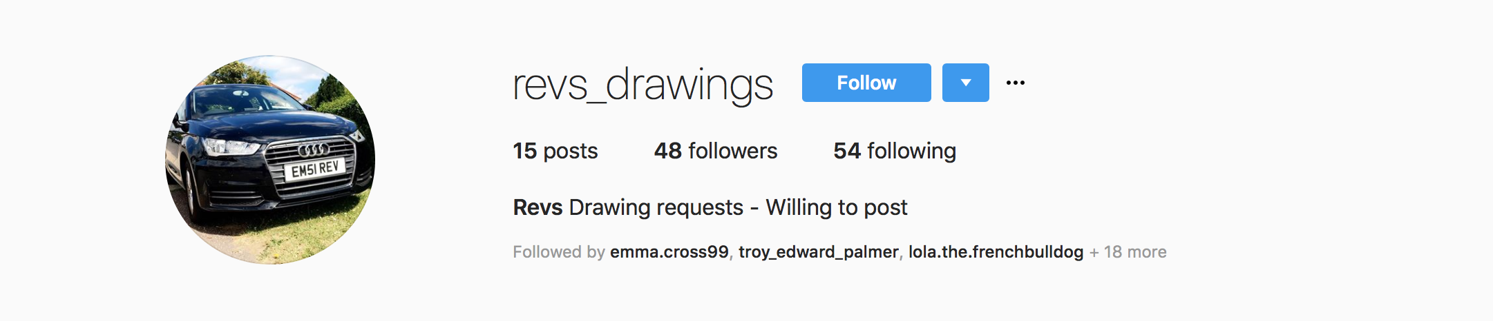
My schedule became very busy.
Not only did I start my degree I also got another retail job as I already worked at new look to support myself financially.
I was working mornings with new look merchandising and processing delivery and all around holding the store
I worked nights until 11pm 5 days a week from 2pm or 5pm depending on the days but then I took on more work fixing and organising their George section in tiptree.
Not to mention I was picking up my own business selling personalised requests of car drawings and rarely shoes. I named my business Rrevs_drawings and have an Instagram I work from.
I interned three days a week for 8 weeks. I had no social life. But a hell of a lot of money and experience.

Slide 4
LESSONS AND THINGS I NOW KNOW.
Paul denicci although this was a brilliant opportunity and great for my CV I felt like the job role wasn't exactly me. I don't like sitting behind a desk all day making spreadsheets and uploading and coding designs. Where I want to be is out collecting inspiration creating concepts/ designs from catwalks and surroundings. I enjoy the creative aspect and pitching my ideas.
New look I still work for. I love this company and I get an insight to vm guidelines within retail stores how they manage marketing and sales and I get to do an online course called new look academy which I have completed all compulsory levels. I extended my knowledge and began courses throughout the business.

Slide 5
George Asda showed me how to re- furbish and re-build old stock. I basically made their sales and stock ramp up through changing the whole place. I was Brought in to do so because I have been working in fashion retail since the age of 16 and never stopped.
My drawings gave me money, social activity, self marketing experience and something I can build from scratch that I was proud of. I created a network of people who would buy from, follow my account and have the opportunity to buy again. Which some people have. I have returning customers and pays just as much as a part time job.
Although I have knowledge across business in fashion, merchandising, managing, designing etc. I do believe I tried doing too many things at once. Paul dennicci soon become just an internship I had cooperated with and helped me realise that I love womenswear and thats the direction I want to proceed into.

Slide 6
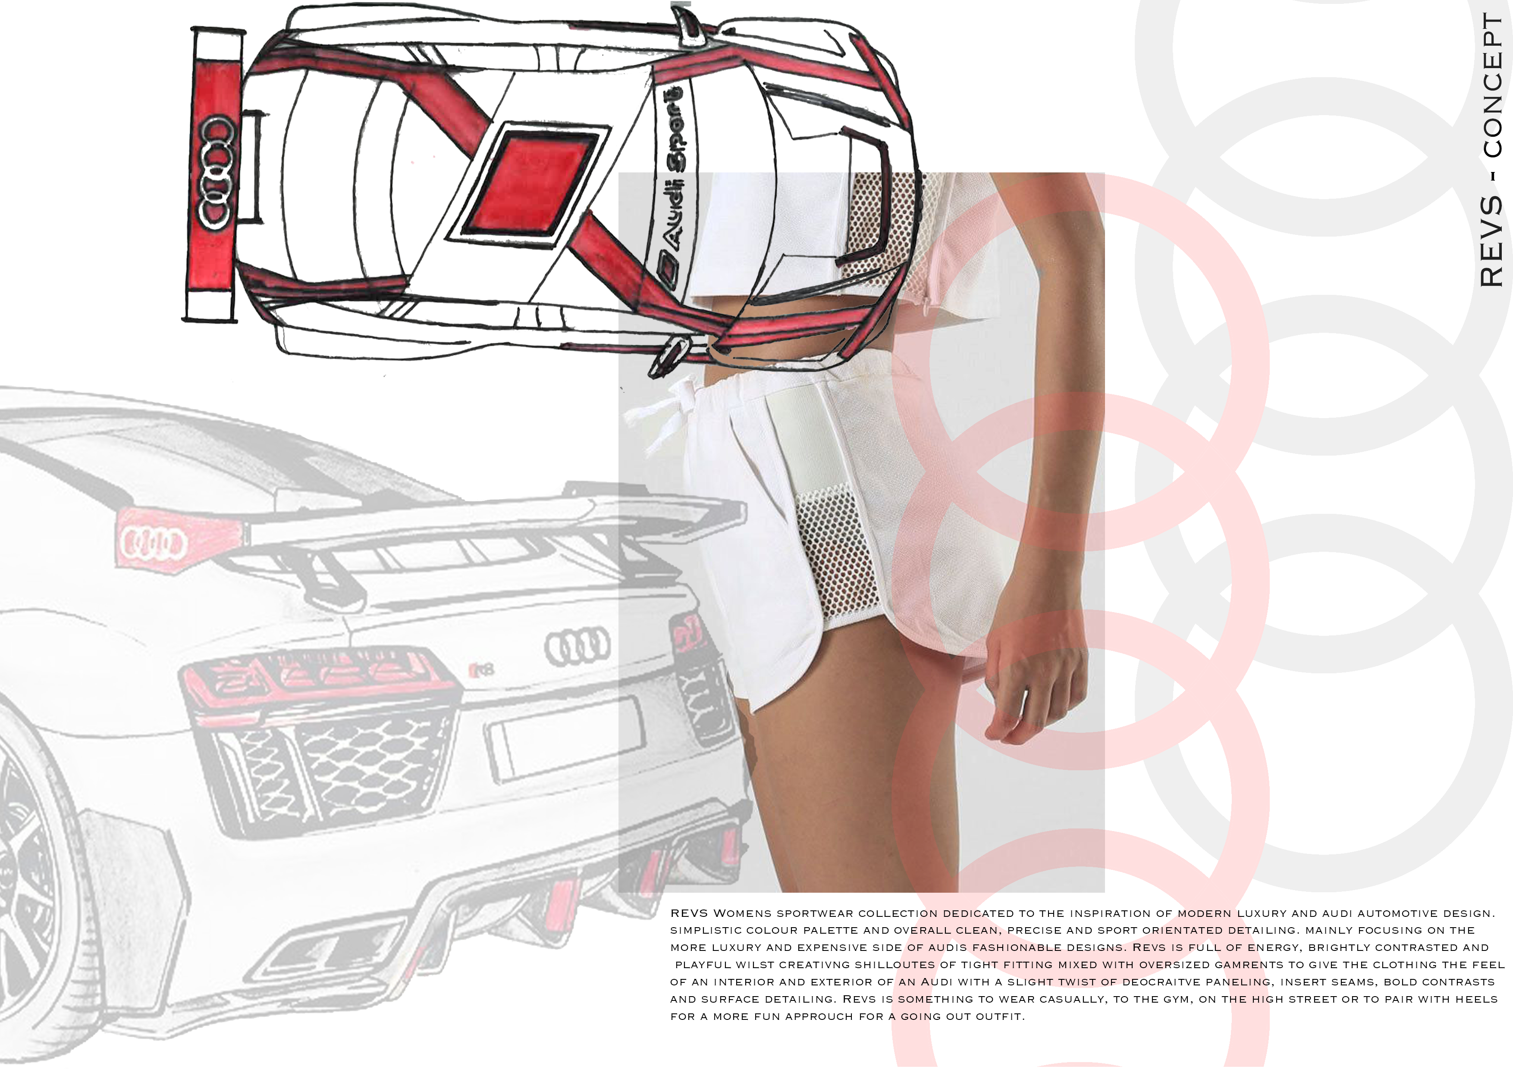
Where I am.
The final year came around quicker than expected. But I wasn't unprepared or between cross roads on what I wanted to base it on.
My interests never change I realised throughout my jobs I was always drawn to sportswear and casuals. Things that were brightly coloured and more out there than the usual popular items in store.
My collection was all about sport. Even the concept which I used. Sports cars. I have an on going love for cars even from a
young age and I remembered how enjoyable second year
was drawing cars and applying that to fashion. Again I
challenged myself to make something that was formally
masculine to feminine and directional.
Throughout the design process I connected with the
collection. Even though I was still working three jobs. I feel like
I utilised all of my developed skills and interests and it really
portrayed me as a designer.
I am currently looking at the next step into the industry
and where I want to be.

Slide 7
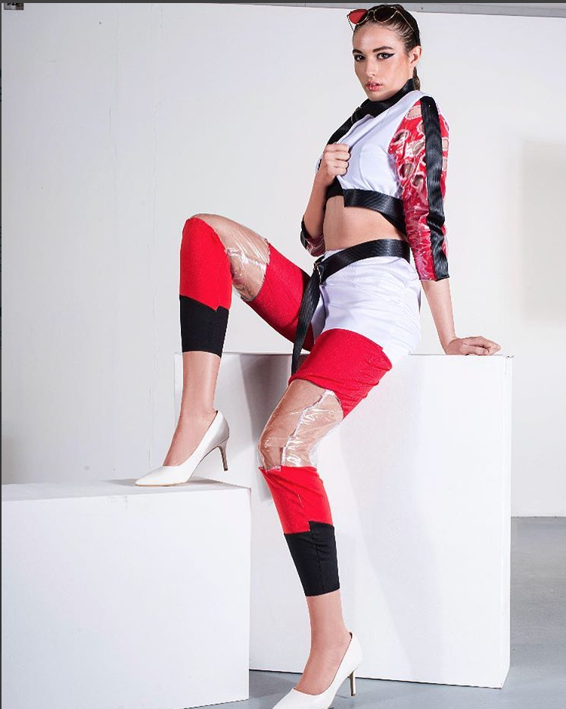
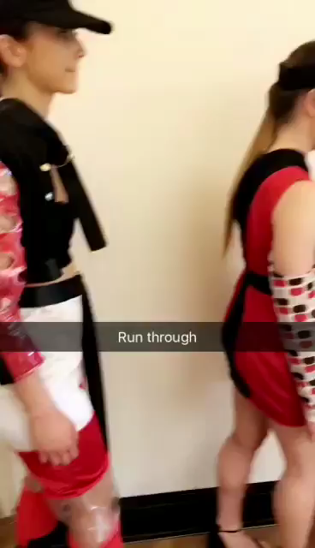
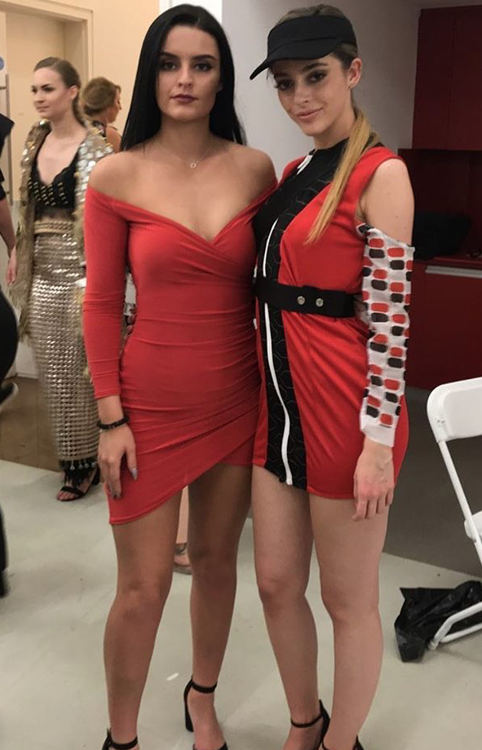
Final FMP Fashion Show.
11th May 2018

Slide 8
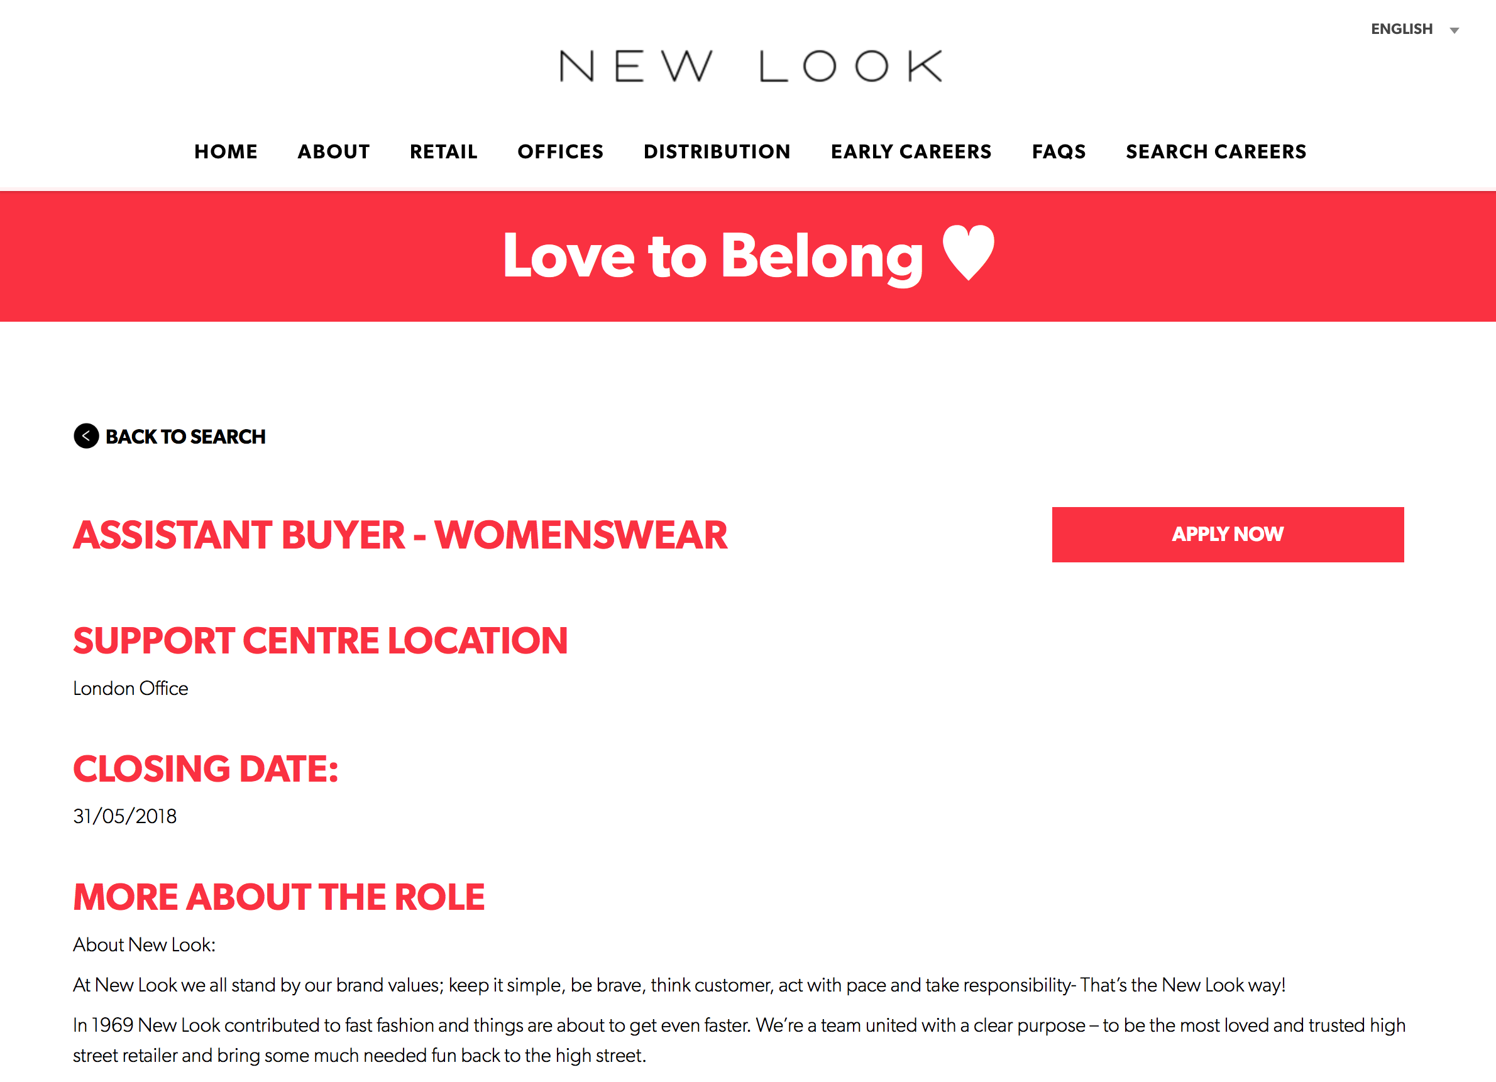
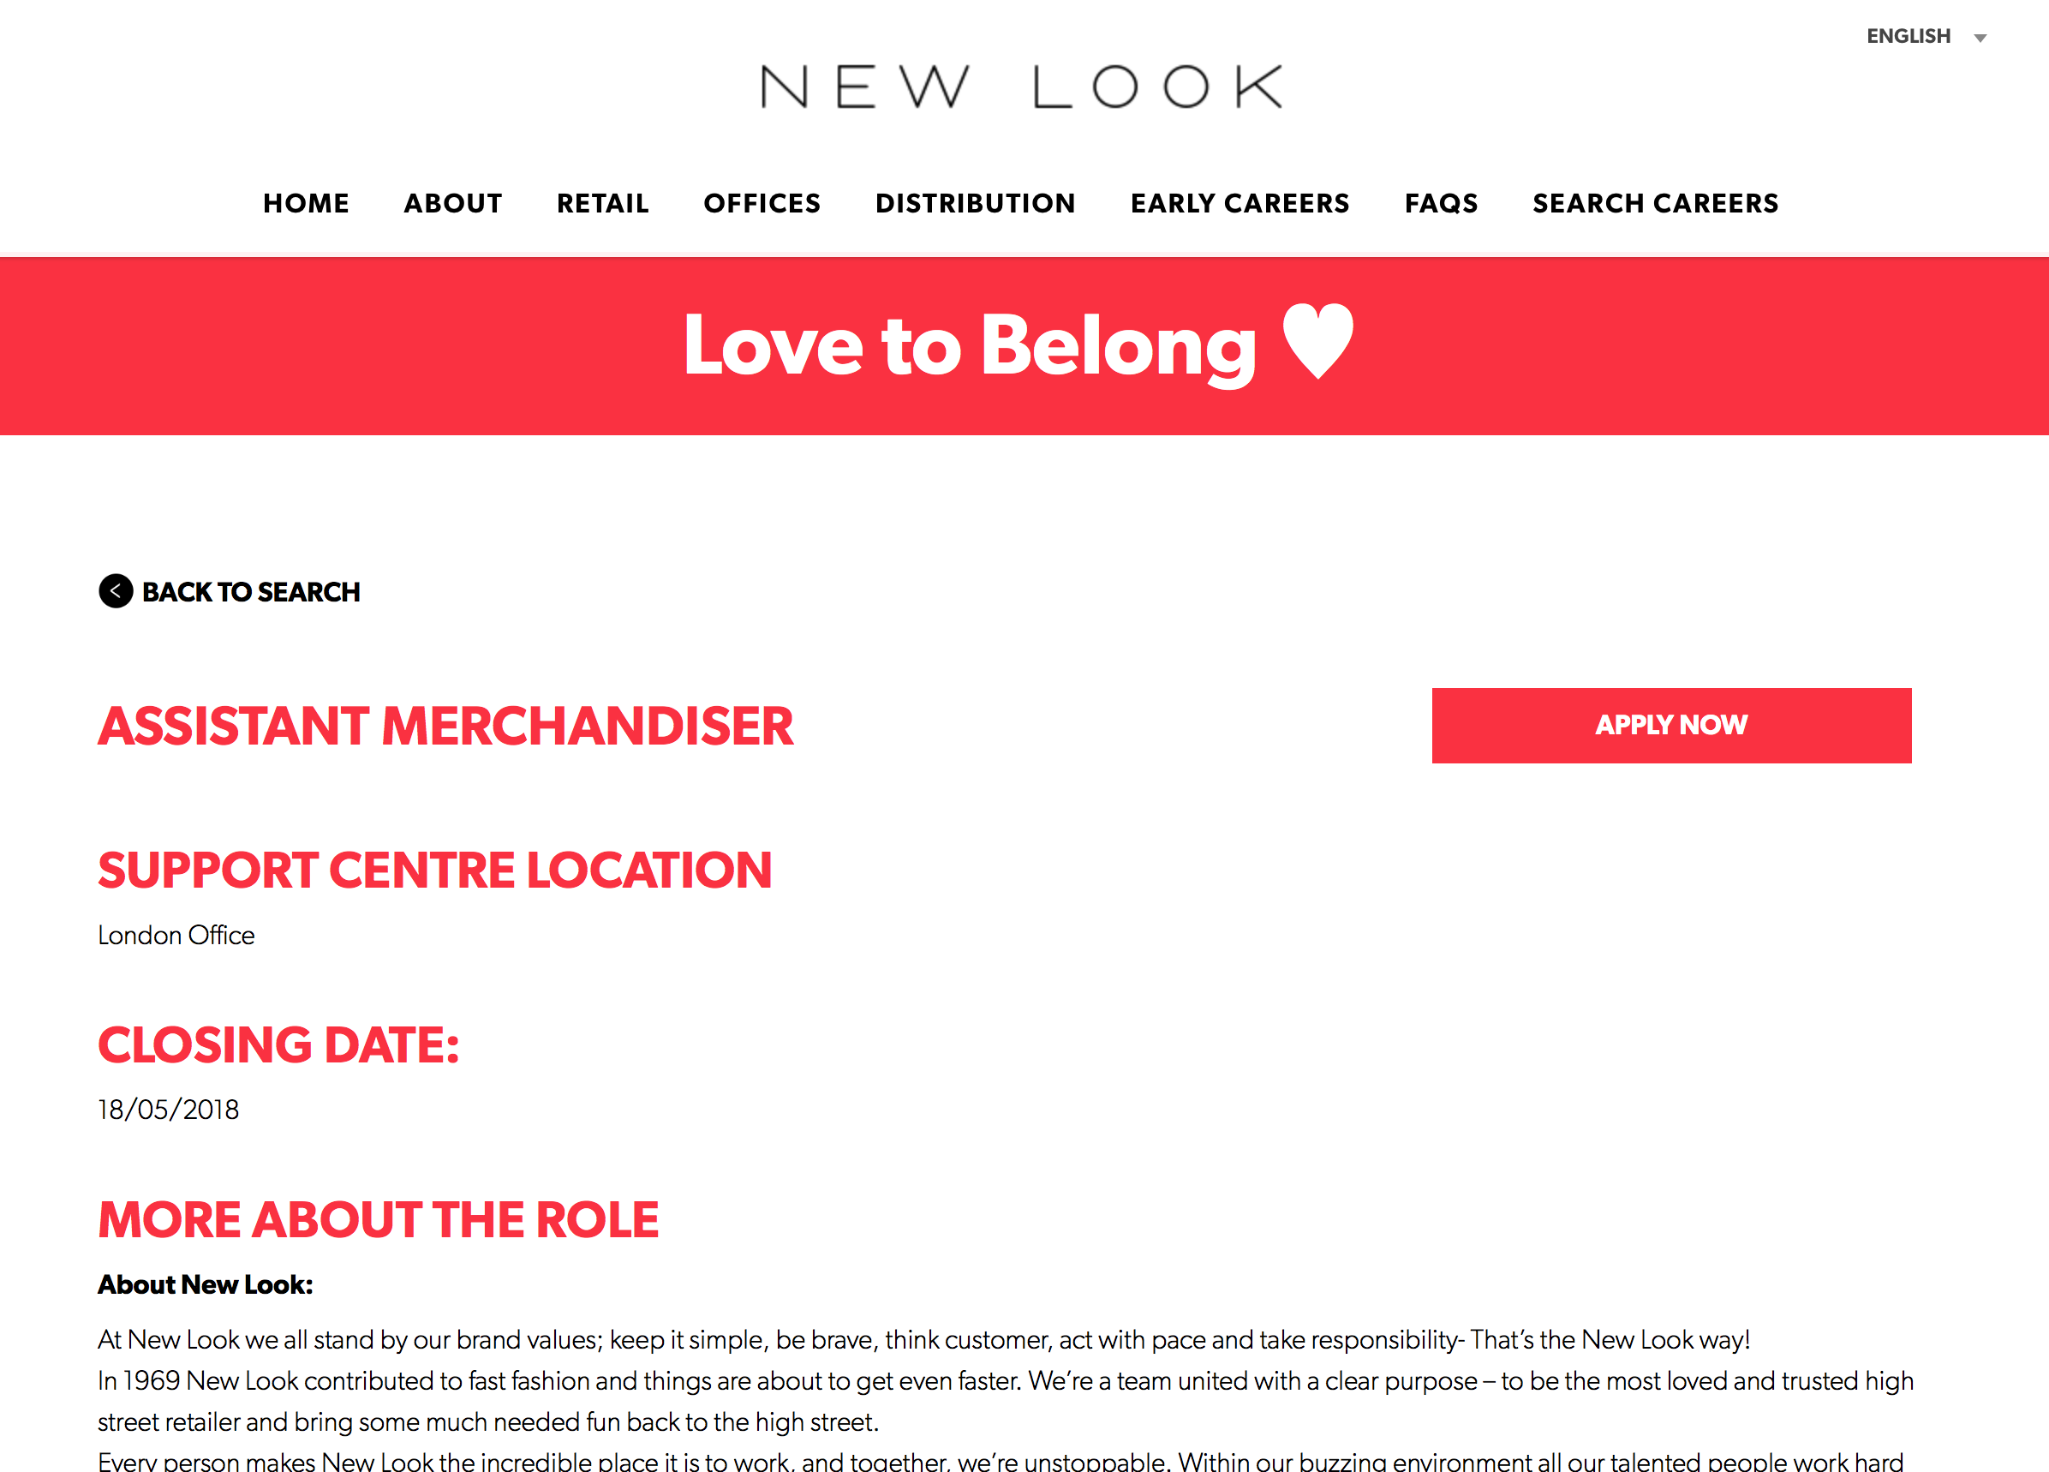
WHERE I WANT TO BE.
Thinking about where in the industry I want to work and I have narrowed it down to three areas…
Buying and selling for a major company like New look, River island or topshop.
Visual regional merchandiser for a company. If I was to go through new look it would be a better and beneficial way as I have worked for them for four years already have the training required and the new look academy extended courses in merchandising and buying. They have places at head office right now that are on their website.

Slide 9
Start my own brand like Maniere devoir, or instagram shops like couture and Fitlete. Theres a start up you own clothing line seminars in manchester. I was talking to someone who owns fitlete about how he started up and told me about the group. He said there are mentors, tips tricks and guideline to ensure I become a successful brand.

Slide 10
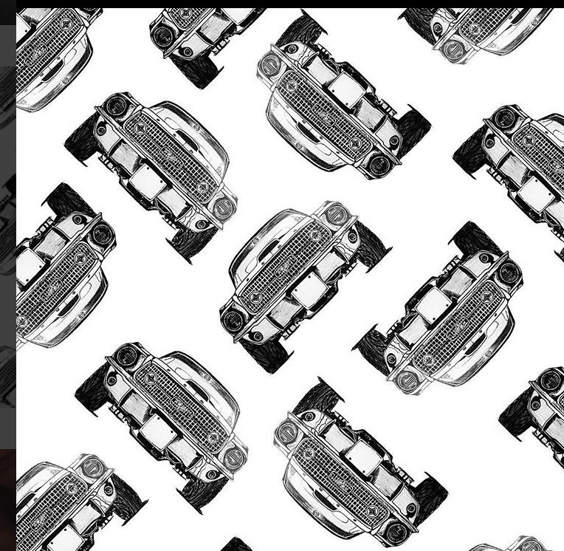
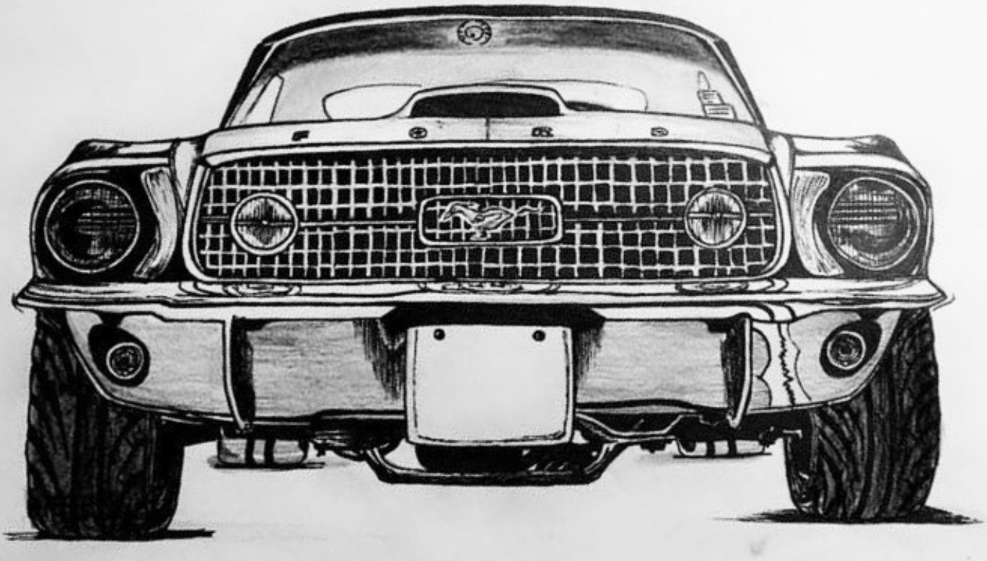
I do also want to carry on with my drawings as its a paid hobby and I feel like its a good little earner however Lee Lapthorne gave me some great tips to take it to the next level and tie it all in together. He suggested printing or textiling my drawings into objects like t shirts, bags, ceramics etc to then take to vintage meet ups or car shows. Would earn more money. Even just framing my drawings and taking them down to a show would earn money.

Slide 11
Other people in the industry.

